Slide 1

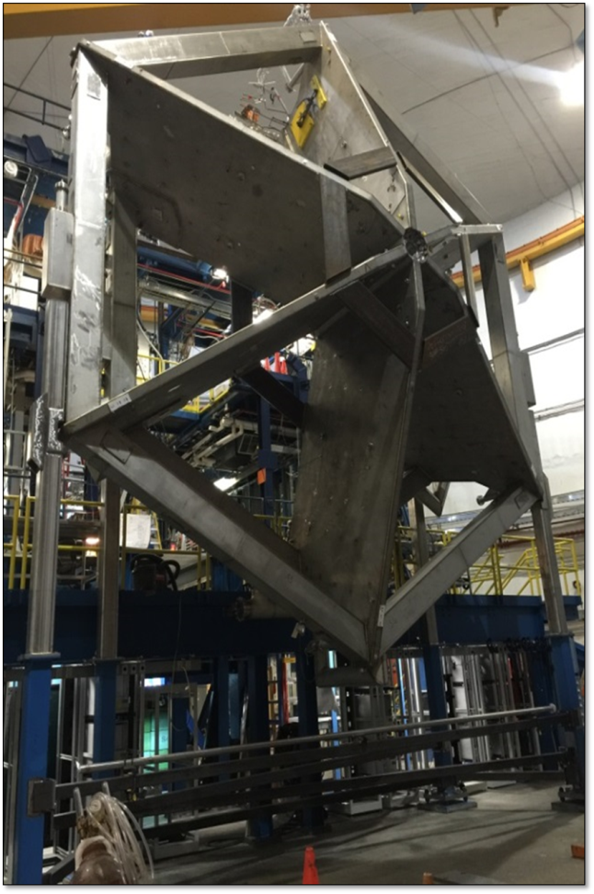

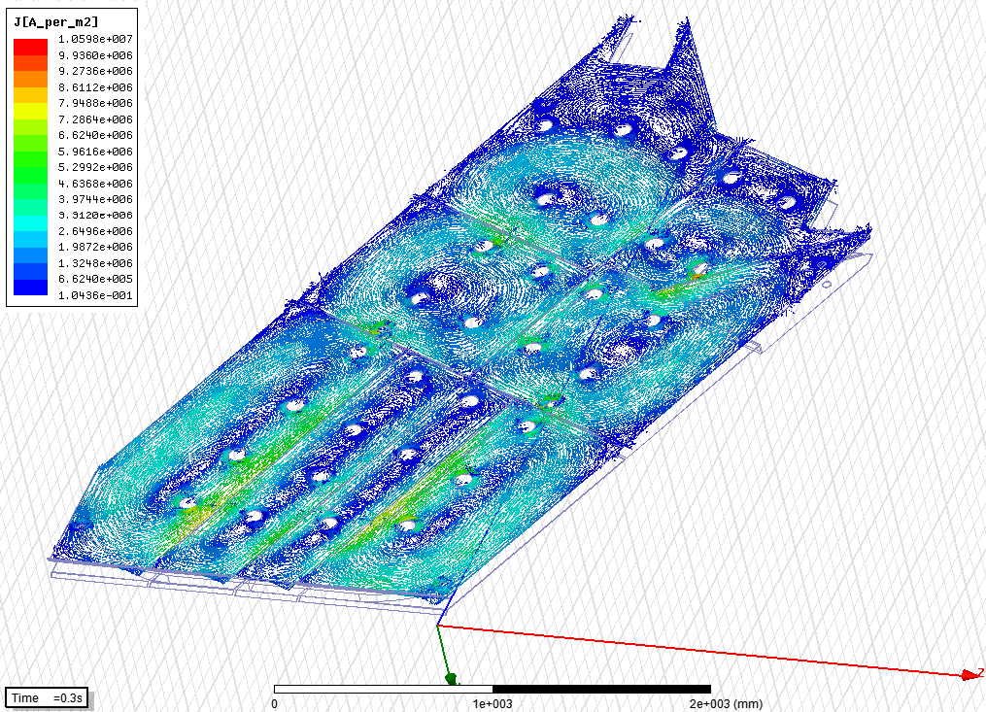
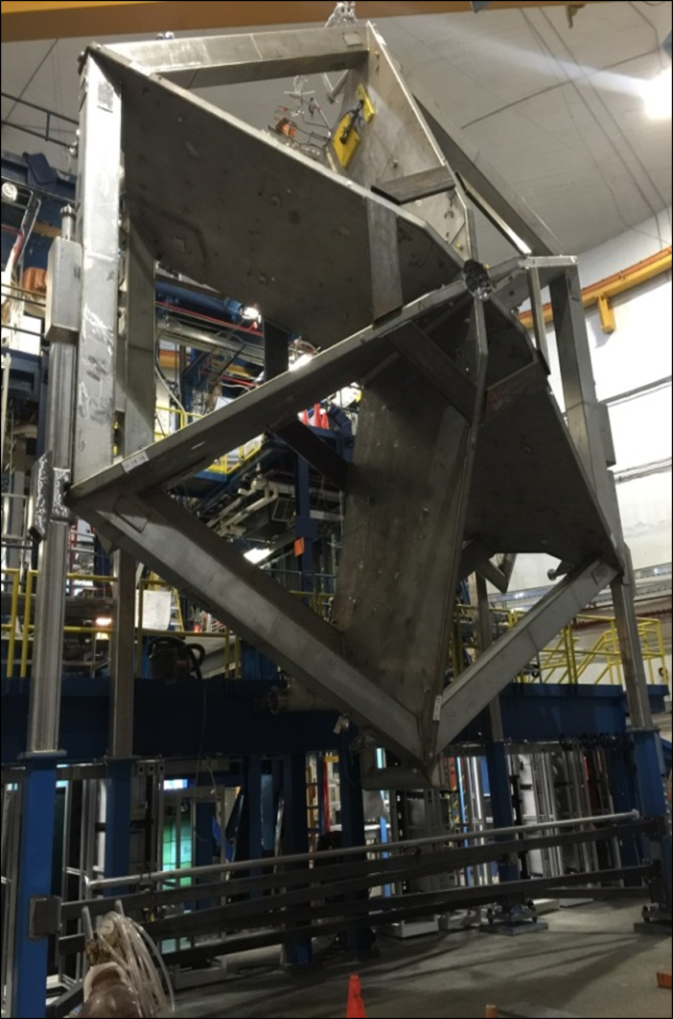
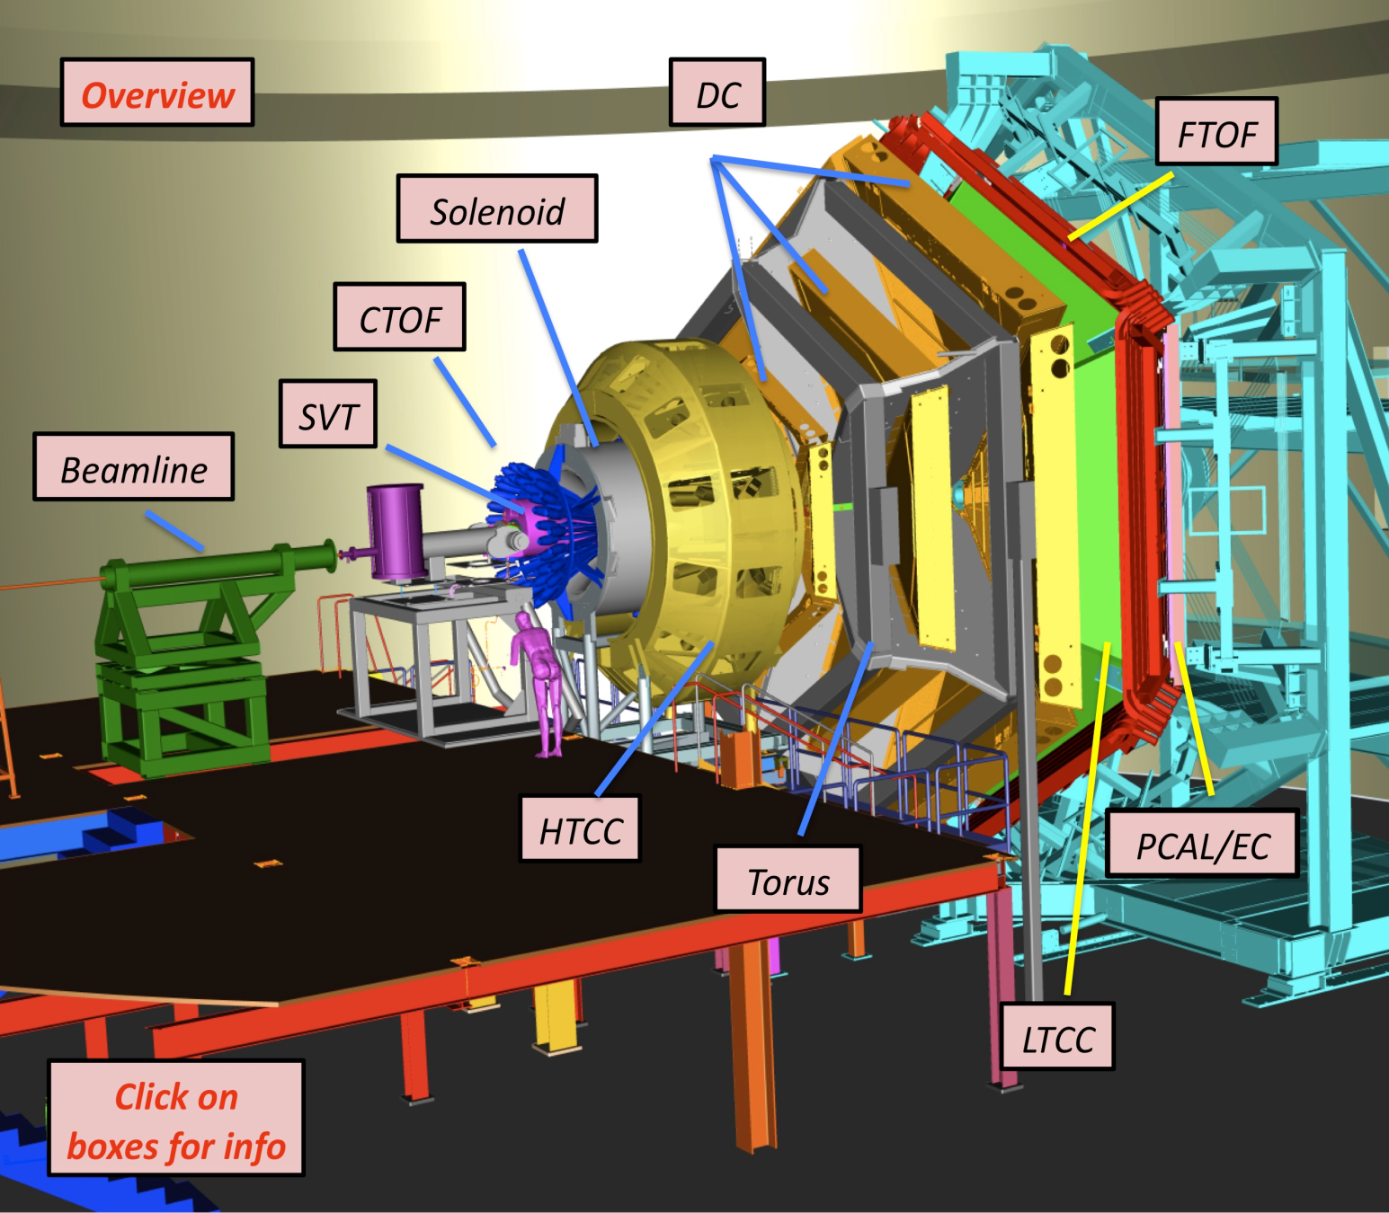
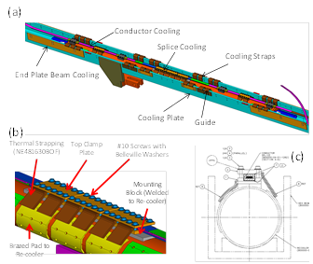
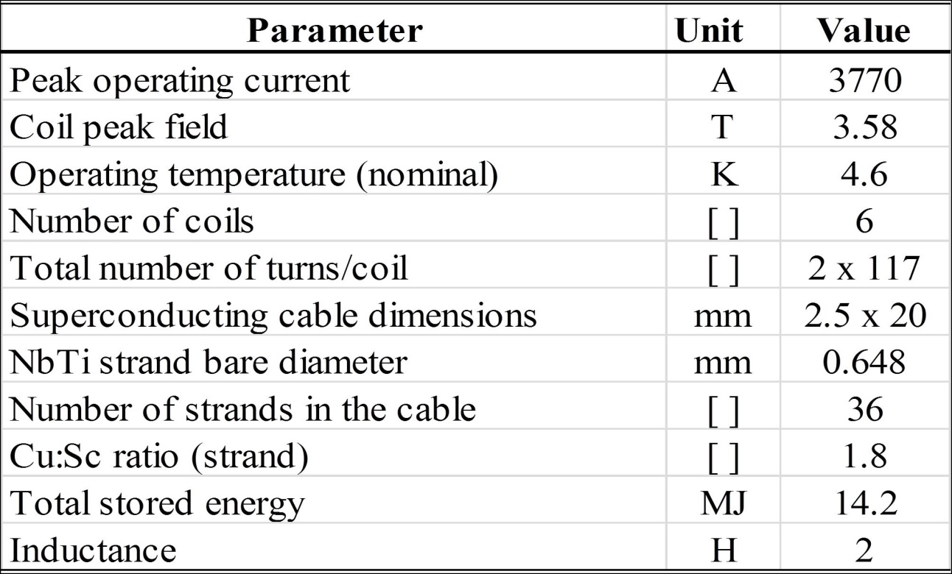
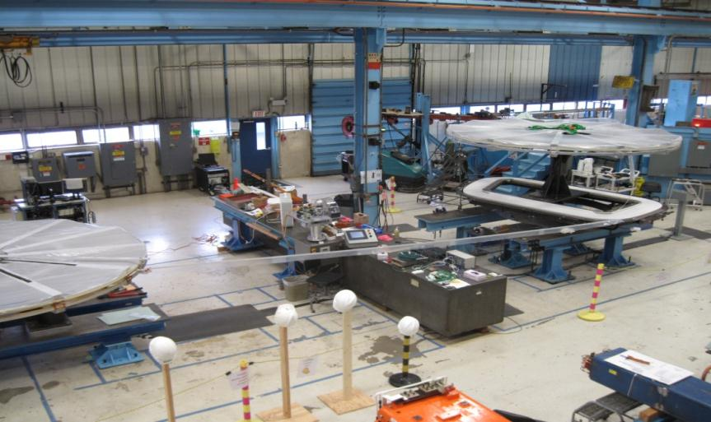
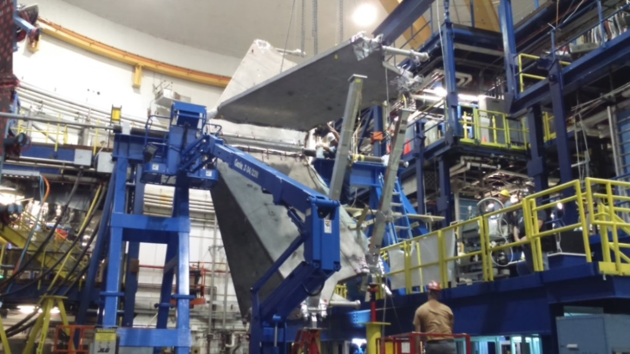
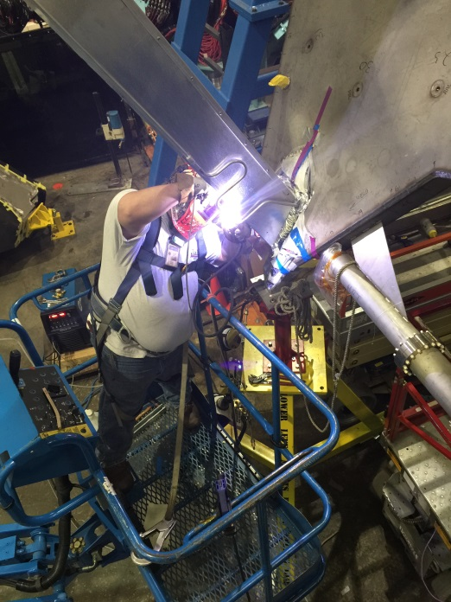
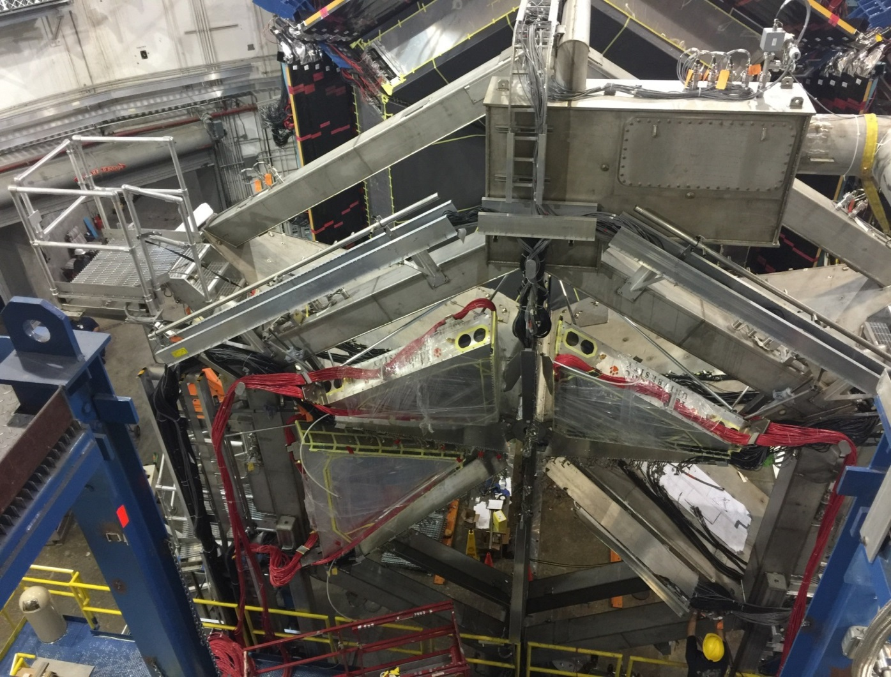
Torus Superconducting Magnet
Thomas Jefferson National Accelerator Facility
What is it?
Designing the Torus Magnet
The Torus Superconducting Magnet is used to:
Bend the particle trajectories so the detectors can measure their momentum
The charged particles produced by nuclear reactions between the beam and the target are steered by the Torus’ magnetic field so that they can be detected by the different physics detectors.
Left: The Torus magnet has 6 superconducting coils located within a vacuum jacket. The coils are cooled to -268ºC (-450ºF). The vacuum jacket is like a thermos flask but in this case helps to keep the coils cold rather than hot.
Top: The Torus magnet surrounded by physics detectors
Tech Specs
Superconducting wire (Niobium Titanium or NbTi)
Length of one coil: 2 Km (1.1 miles)
Number of NbTi strands / coil: 36
Number of filaments / strand: 4166
So one single wire has 150,000 filaments.
Some design calculations. Top left: Circulating currents in the thermal shield of a superconducting coil Top Right: Some of the key equations used to design the superconducting coils. Bottom Left: Design of the joints between the superconducting coils. Bottom Right: Electrical resistance (voltage/current) of the joints between the coils in various magnetic fields.
Building and Installing the Torus
Did you know?
The freezer in your refrigerator at home keeps your ice-cream cold at -18ºC (about 0ºF). The Torus superconducting coils are kept cold at -268ºC (-450ºF) – nearly as cold as outer space!
If you took all the superconducting filaments used to wind the magnet coils and laid them end-to-end, they would stretch for more than one million miles – that’s 4 times the distance to the moon!
Superconductivity was discovered at 4pm in the afternoon on Saturday April 08th 1911 by a Dutchman, Kamerlingh Onnes.
The Torus magnet weighs 28 tons – that’s 2 school buses full of kids who have just had lunch!
The Torus magnet took 3 years and more than 200 people to build!
When the Torus is fully powered up, it has as much energy as 9 Toyota SUVs traveling at 75 MPH on the highway or nearly 7 pounds of TNT!
Niobium Titanium is the superconductor used in the Torus coils. The metal Niobium is presently only mined in two places on Earth – Brazil and Canada.
The magnetic field produced by the Torus magnet is more than 71000 times stronger that the Earth’s magnetic field!
A single Torus wire has 150,000 Niobium Titanium filaments.
YOU ARE STANDING NEXT TO A UNIQUE SUPERCONDUCTING MAGNET! Go on… take a selfie with the CLAS12 Torus and tell the world!
Superconducting coils being wound at Fermilab, Chicago
Superconducting coils being installed in Hall B, JLab
Contributing Institutions
Jefferson Lab, Newport News, VA, USA
Fermilab, Chicago, IL, USA
Completing the installation of the superconducting coils
Installing physics detectors on the completed Torus magnet

